Slide 1
MACHINE LEARNING
(25SC2107E)
Air Quality Index Prediction Using Ridge and Lasso Regression
Team Members
Name: V.VedaPriya
Rollno. 2520030376
Name: K.SaiSamyuktha
Rollno. 2520030443
Under the Esteemed Guidance of

Slide 2
Contents
Abstract
Introduction
Problem Statement and Objectives
Hardware and Software requirements
Results
Conclusion
Future Scope

Slide 3
Abstract
Air pollution is a major environmental problem that can affect human health and the quality of life. The Air Quality Index (AQI) is used to represent how clean or polluted the air is based on the concentration of different pollutants present in the atmosphere. Predicting AQI can help people understand air-quality conditions and take necessary precautions.
This project develops a machine-learning system to predict AQI using previous air-quality data. Parameters such as PM2.5, PM10, NO₂, SO₂, CO, and O₃ are used as input features. The dataset is cleaned and analyzed before training Ridge and Lasso Regression models. Their performance is evaluated using MAE, MSE, RMSE, and R² score, and the better-performing model is used for AQI prediction.

Slide 4
Introduction
Air pollution is an important environmental concern because different pollutants present in the atmosphere can negatively affect human health and the surrounding environment. AQI provides a simple way to represent the level of air pollution by considering the concentration of different pollutants. Therefore, predicting AQI can help in understanding and monitoring air-quality conditions.
Machine learning can identify patterns and relationships between pollutant concentrations and their corresponding AQI values. In this project, historical air-quality data is used to develop a prediction system using Ridge Regression and Lasso Regression. These models help analyze the relationship between the selected pollutant parameters and AQI.

Slide 5
Problem Statement and Objectives
Problem Statement:
Air-quality conditions continuously vary depending on the concentration of pollutants present in the atmosphere. Understanding these changes and predicting AQI from pollutant values can help in pollution analysis and air-quality monitoring. Hence, there is a need for a machine-learning system that can learn from previous air-quality data and provide AQI predictions for new pollutant values.
Objectives:
The main objective of this project is to develop an AQI prediction system using Ridge and Lasso Regression. The project focuses on cleaning and preparing the dataset, analyzing relationships between pollutants and AQI, training both models, and evaluating their performance using suitable regression metrics. The final objective is to use the better-performing model for predicting AQI.

Slide 6
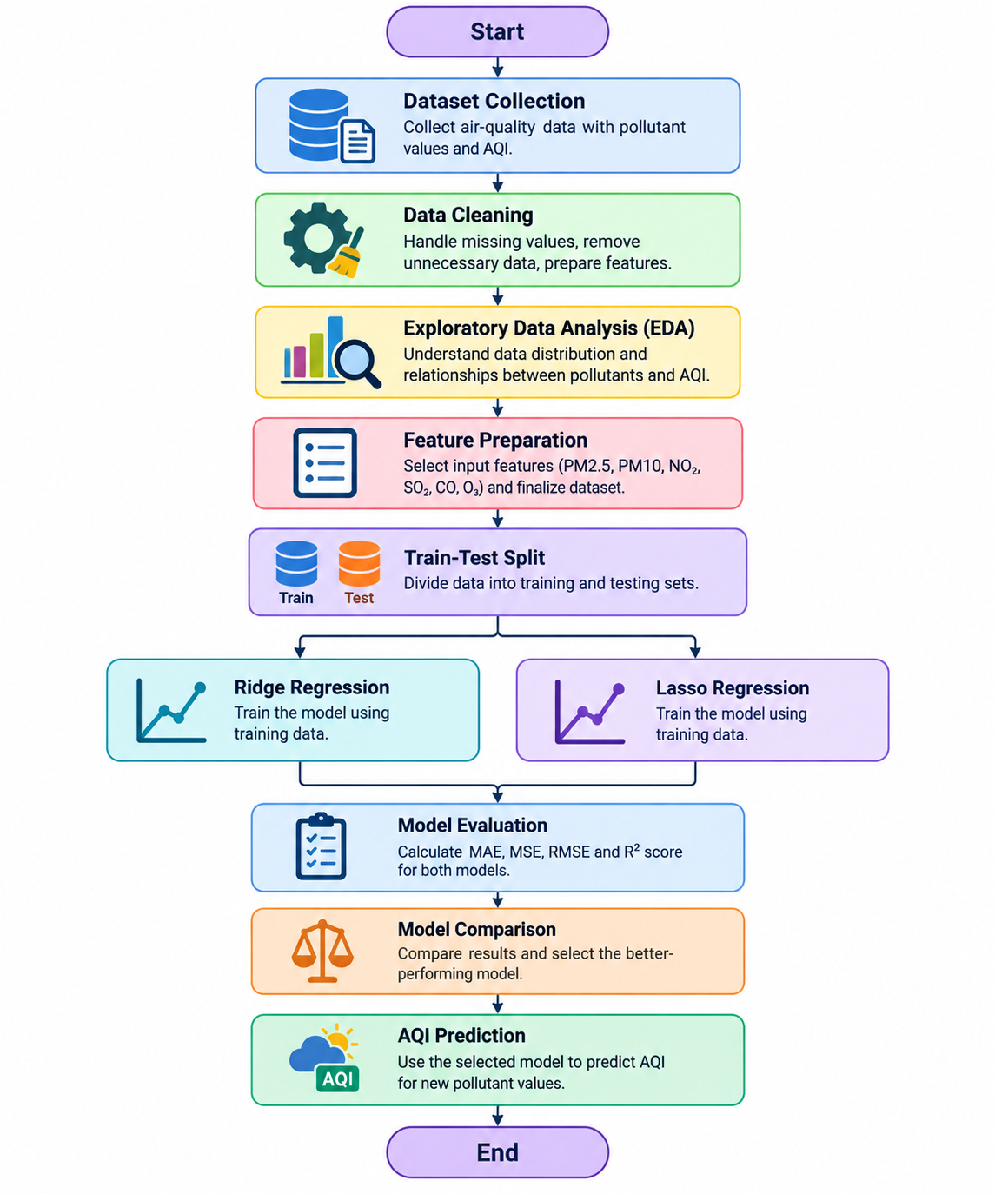
Flow Chart

Slide 7
Results
The developed system trains both Ridge Regression and Lasso Regression models using the prepared air-quality dataset. After training, the models are tested using unseen data to determine how accurately they can predict the corresponding AQI values. The predictions are compared with the actual AQI values from the testing dataset.
The performance of both models is measured using MAE, MSE, RMSE, and R² score. These evaluation results are used to compare the prediction performance of Ridge and Lasso Regression. Based on the obtained results, the better-performing model can be selected for predicting AQI when new pollutant values are provided.
.

Slide 8
Hardware and Software requirements
The project can be implemented using a standard computer system with a suitable processor, minimum 4 GB RAM, sufficient storage, keyboard, mouse, and display. Since the project mainly involves data preprocessing, visualization, and machine-learning model training, a basic computer system is sufficient for implementation.
The software requirements include Python 3.x along with libraries such as Pandas, NumPy, Matplotlib, Seaborn, and Scikit-learn. Pandas and NumPy are used for data processing, Matplotlib and Seaborn are used for visualization, and Scikit-learn is used for implementing Ridge and Lasso Regression and evaluating the models.

Slide 9
Conclusion
This project demonstrates how machine learning can be applied to predict the Air Quality Index using different pollutant parameters. The air-quality dataset is first cleaned and analyzed, after which the selected pollutant features are used for training the regression models. This preprocessing and analysis helps prepare the data for effective AQI prediction.
Ridge Regression and Lasso Regression are used to develop and compare the prediction models. Ridge applies L2 regularization to improve model stability, while Lasso applies L1 regularization and can help identify less useful features. The models are evaluated using different regression metrics, and the better-performing model can be used to predict AQI from new pollutant values.

Slide 10
Future Scope
The proposed AQI prediction system can be extended by integrating real-time air-quality data so that predictions can be generated continuously according to changing environmental conditions. Larger and more diverse air-quality datasets can also be used to improve the model's ability to work with different locations and pollution conditions.
In the future, the system can be developed into a web or mobile application that provides AQI predictions through an easy-to-use interface. Advanced machine-learning and deep-learning techniques can also be explored to improve prediction performance. Visual dashboards and alert systems could further help users understand and respond to unhealthy air-quality conditions.

Slide 11
Thank you

